Slide 1
Predicting House Prices Using Machine Learning Algorithm

Slide 2
Contents
Introduction
Problem Statement
Data Exploration
Pre Processing
Machine Learning Approach
Checking the accuracy of the model
Results & Conclusion

Slide 3
Introduction
In the ever-evolving real estate landscape, the ability to accurately forecast property values is not just a challenge but a crucial aspect for various stakeholders – from homebuyers and sellers to real estate professionals.
In this presentation, we will explore a machine learning algorithm meticulously designed to address this challenge and provide robust predictions for house prices.
The fusion of advanced machine learning algorithms with the intricate nuances of housing markets marks a pivotal juncture in the evolution of real estate. Our objective is not merely to predict house prices; it is to redefine how we approach this challenge, leveraging the capabilities of a model designed to adapt, learn, and provide insights beyond traditional methodologies.

Slide 4
Problem Statement
The real estate industry stands on the cusp of a data-driven revolution, where accurate predictions of house prices hold the key to informed decision-making for both buyers and sellers. However, the dynamic nature of housing markets, influenced by myriad factors, poses a formidable challenge in achieving precise price forecasts. The problem at hand is to develop a robust machine learning model capable of deciphering the intricate patterns within diverse datasets, considering variables such as location, size, amenities, and market trends. The goal is to transcend traditional valuation methods and create a predictive framework that not only meets but surpasses the expectations of stakeholders. In doing so, we aim to revolutionize the accuracy and reliability of house price predictions, providing a transformative tool for real estate professionals, investors, and anyone navigating the complexities of property transactions.

Slide 5
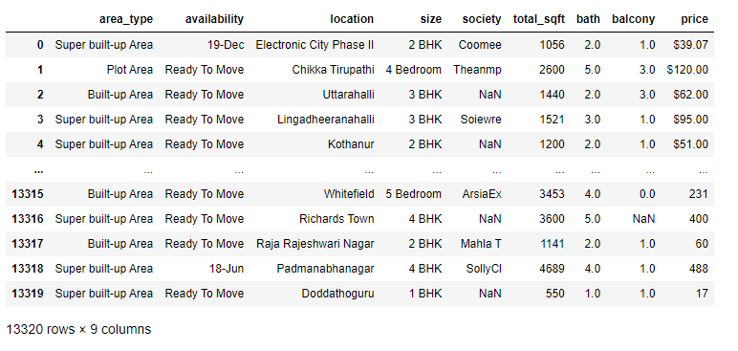
Data Exploration For this we are taking a data set with the size of 13320x9

Slide 6
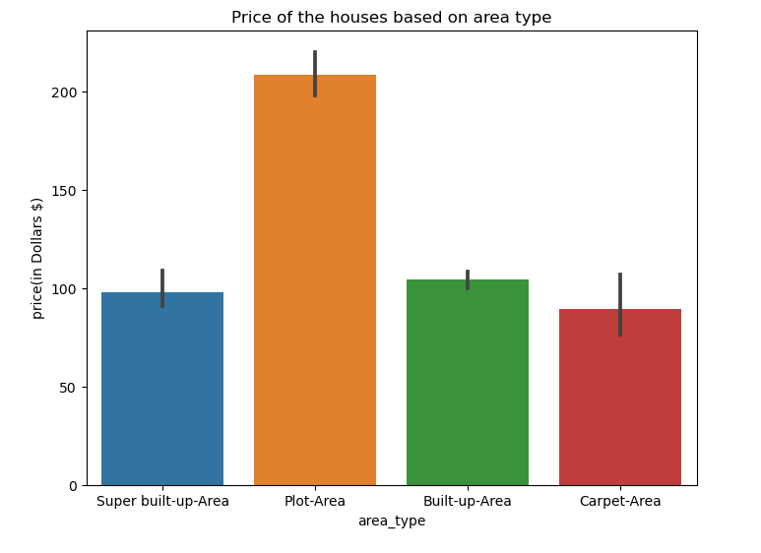
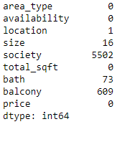
Data Exploration
There are 5 Columns with null values
Location column has 1 null values.
Size column has 16 null values
Society column has 5502 null values
Bath column has 73 null values
balcony column has 609 null values
We can see that Plot-area in area_type column has the highest distribution of price.

Slide 7
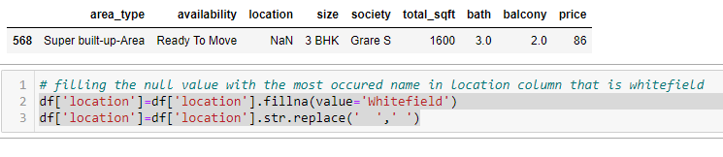
Pre-Processing
Area-type column
Here replacing empty spaces with '-'.
Location column
The location column has 1 null value hence filling it with most occurred name in the location column that is 'Whitefield'.

Slide 8
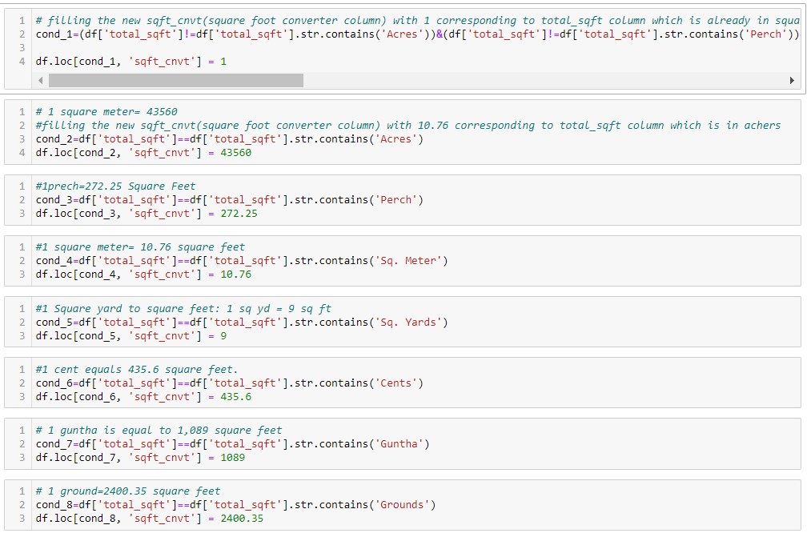
Pre-processing
Total_sqft column
Total_sqft column is an object column but this column has to be converted to numerical column .
In this column, the carpet area of the house has been given in various forms such as square meters, square yards, perch, acres, ground, guntha, and cents, hence the conversion to square feet as a standard approach.

Slide 9
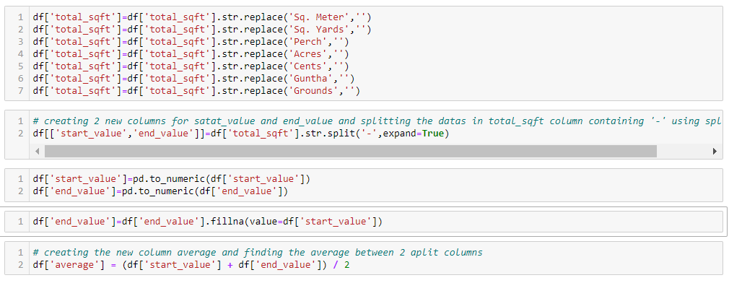
Pre-Processing
creating 2 new columns for satat_value and end_value and splitting the datas in total_sqft column containing '-' using split method.
creating the new column average and finding the average between 2 aplit columns.
multiplying the average column and sqft_cnvt column to get the final square feet.
drop the columns that are not required.

Slide 10
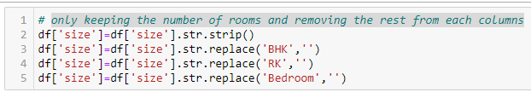
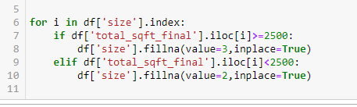
Pre-Processing
Size Column
Only keeping the number of rooms and removing the rest from each columns.
Fill the missing values of each room by understanding the house size .
For house size greater than 2500 sqft fill it as 3 rooms.
For house size lesser than 2500 sqft fill it as 2 rooms.

Slide 11
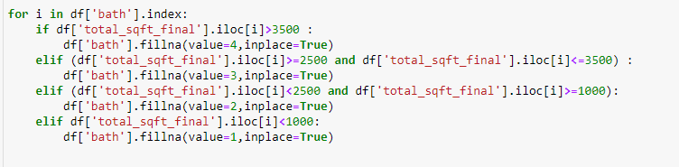
Pre-Processing
Society column
The society column has 5502 missing values.
Randomly filling the missing values in society column with the highest occoured values.
Bath column
There are 73 missing values in the bath column .
Hence filling them based on house square feet.

Slide 12
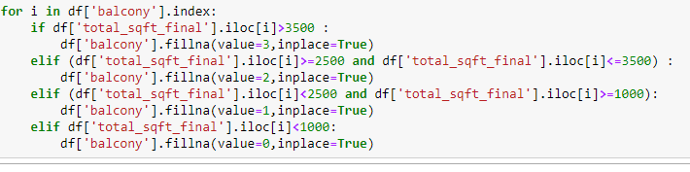

Pre-Processing
Balcony column
There are 609 missing values in the balcony column.
Hence filling them based on house square feet.
Availability column
The availability column does not play an import role in the price prediction of the house hence better to drop the column.

Slide 13
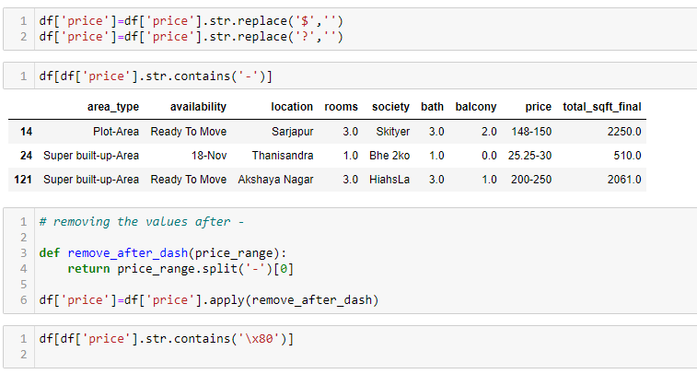
Pre-Processing
Price Column
The price column is in the form of object dtype; therefore, it needs to be converted into numerical dtype.
Removing symbols like '$,?,-' etc from the column.

Slide 14
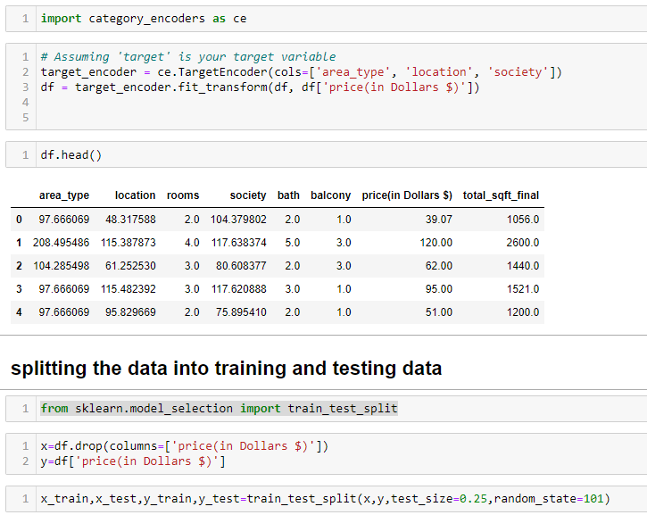
Future Engineering & Scaling
Utilized category encoders for converting categorical columns into numerical ones.
Chose the Target encoding method, considering the presence of multiple values in a category column.
Applied encoding specifically to columns like 'area_type,' 'Location,' and 'society.'
Following the encoding process, partitioned the dataset into training and testing sets.
This division into training and testing sets was done to facilitate training and prediction using machine learning algorithms

Slide 15
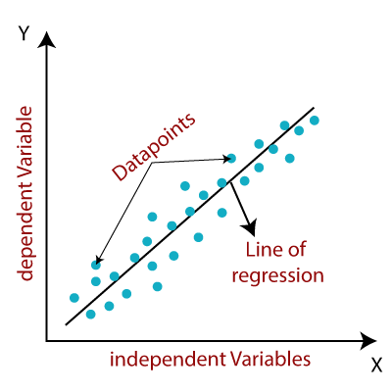
ML Algorithm-Linear Regression
Linear regression attempts to model the relationship between two variables by fitting a linear equation to observed data. One variable is considered to be an explanatory variable, and the other is considered to be a dependent variable. For example, a modeler might want to relate the weights of individuals to their heights using a linear regression model.
y^=b0 +b1 x1 +b2 x2 +…+bn xn
where:
y is the dependent variable,
x1,x2 ,…,xn are the independent variables,
b0 is the y-intercept,
b1,b2,,…,bn are the coefficients representing the change in y with a one-unit change in x1 ,x2 ,…,xn respectively.

Slide 16
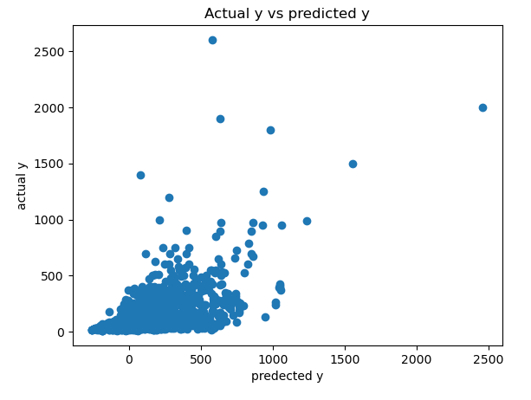
ML Algorithm- Linear Regression
Gradient Descent is an optimization algorithm commonly used in linear regression to find the minimum of the cost function. The cost function measures the difference between the predicted values of the model and the actual values in the training data. The goal is to minimize this cost function to obtain the best-fitting linear regression model. Gradient decent will always give you a updated value for b which is better than the previous.
Acc to gradient decent
b(u)=b(c)-(n*(dJ/db))
b(u)--> updated value of b
b(c)--> current value of b
n--> learning rate
dJ/db= derivation of cost function w.r.t b

Slide 17
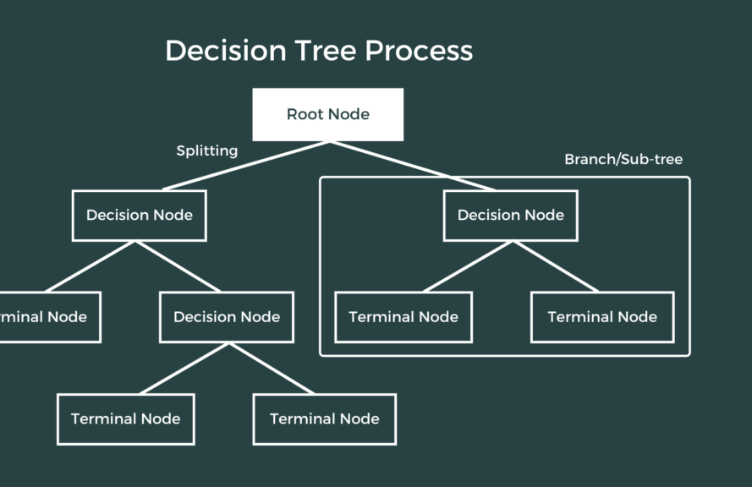
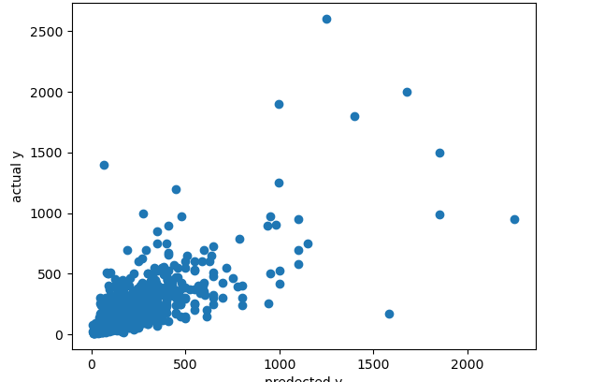
ML Algorithm- Decision Tree
Step 1: Find the best feature and corresponding rule to split the data.
Step 2: Check if the child/decision nodes need further splitting. If not, assign a label to the node; if yes, repeat Step 1.

Slide 18
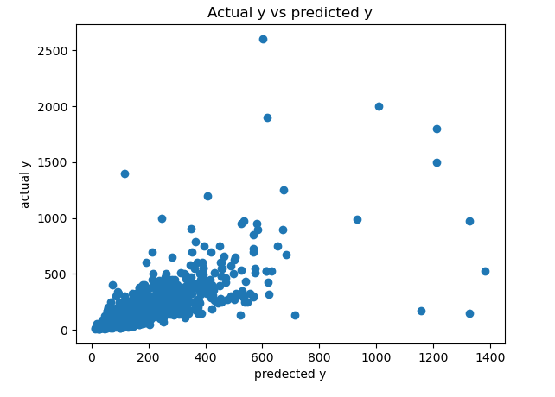
ML Algorithm- K Nearest Neighbors
The K-NN working can be explained on the basis of the below algorithm:
Step-1: Select the number K of the neighbors
Step-2: Calculate the Euclidean distance of K number of neighbors
Step-3: Take the K nearest neighbors as per the calculated Euclidean distance.
Step-4: Among these k neighbors, count the number of the data points in each category.
Step-5: Assign the new data points to that category for which the number of the neighbor is maximum.
Step-6: Our model is ready.

Slide 19
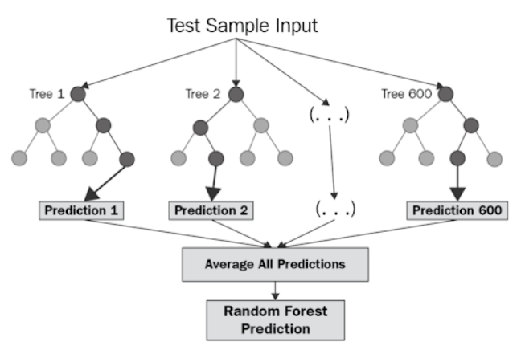
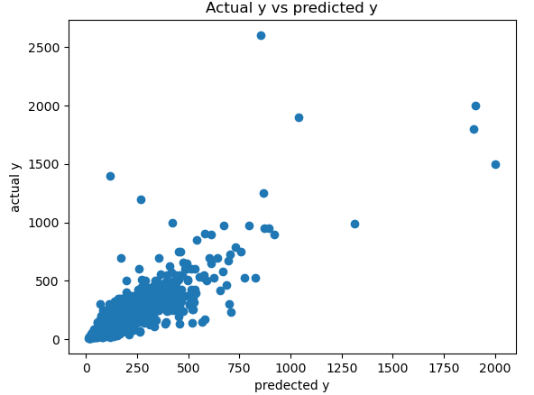
ML Algorithm- Random forest
Random forest operates by constructing a multitude of decision tree at training time and outputting the class that’s the mode of the classes (classification) or mean prediction (regression) of the individual trees.
A random forest is a meta-estimator (i.e. it combines the result of multiple predictions), which aggregates many decision trees with some helpful modifications:
The number of features that can be split at each node is limited to some percentage of the total (which is known as the hyper-parameter). This limitation ensures that the ensemble model does not rely too heavily on any individual feature and makes fair use of all potentially predictive features.
Each tree draws a random sample from the original data set when generating its splits, adding a further element of randomness that prevents overfitting.

Slide 20
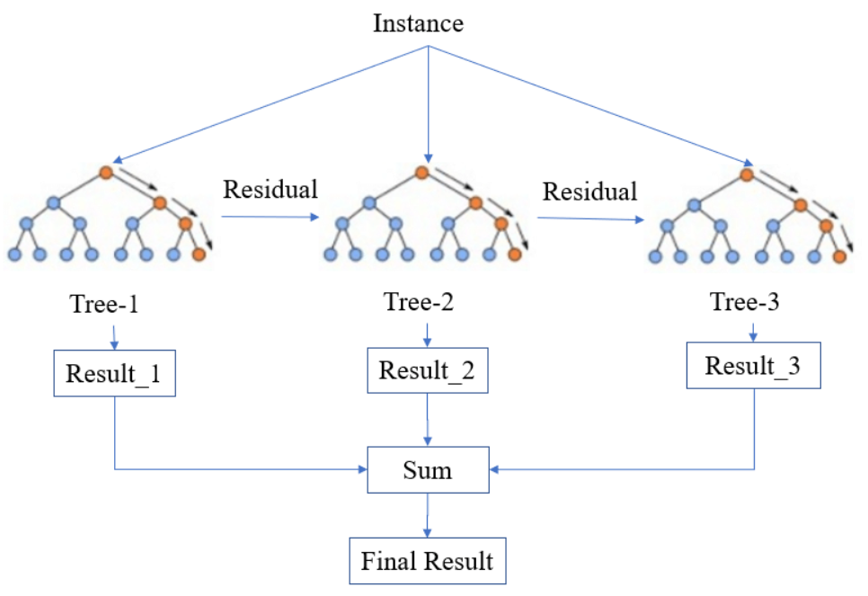
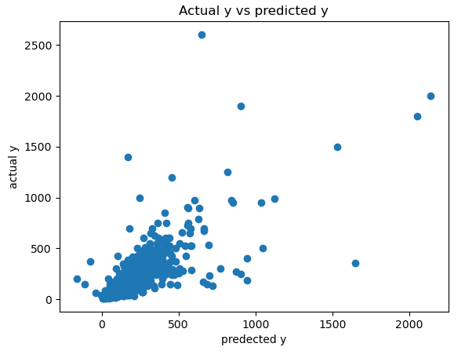
ML Algorithm-Extreme Gradient Boosting (XGBoost)
Gradient boosting refers to a class of ensemble machine learning algorithms that can be used for classification or regression predictive modeling problems.
Ensembles are constructed from decision tree models. Trees are added one at a time to the ensemble and fit to correct the prediction errors made by prior models. This is a type of ensemble machine learning model referred to as boosting.

Slide 21
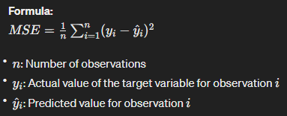
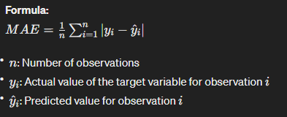
Checking The Accuracy of the Model
In regression, where the goal is to predict a continuous numeric value, we use different evaluation metrics. Here are some common metrics for assessing the accuracy of a regression model:
1) Mean Squared Error (MSE):
Mean Squared Error measures the average squared difference between predicted and actual values. It penalizes larger errors more than smaller ones.
2) Mean Absolute Error (MAE):
Mean Absolute Error is the average absolute difference between predicted and actual values. It provides a measure of the average magnitude of errors.

Slide 22
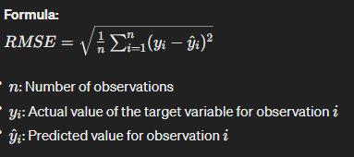
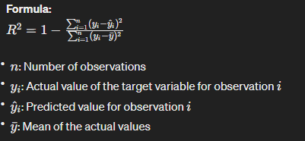
Checking The Accuracy of the Model
3) Root Mean Squared Error (RMSE):
Root Mean Squared Error is the square root of the Mean Squared Error. It provides an interpretable measure of the average magnitude of errors in the same units as the target variable.
4) R-squared (Coefficient of Determination):
R-squared measures the proportion of the variance in the dependent variable that is predictable from the independent variables. It ranges from 0 to 1, where 0 indicates that the model does not explain any variance, and 1 indicates perfect prediction.

Slide 23
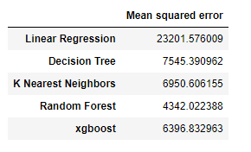
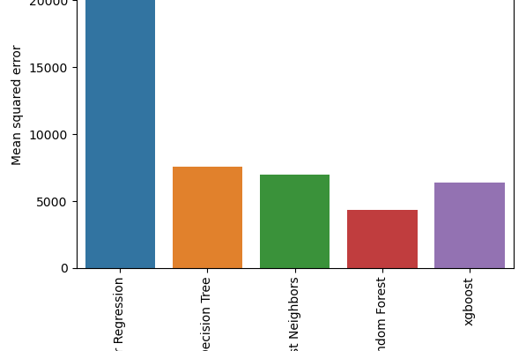
Results & Conclusion
Random Forest Performs Best:
The Random Forest model has the lowest mean squared error (4342.022388), indicating that, on average, its predictions have the smallest squared differences from the actual values among the models compared.
Decision Tree and K Nearest Neighbors (KNN):
The Decision Tree and K Nearest Neighbors models have higher mean squared errors compared to Random Forest but lower than Linear Regression and XGBoost. They perform reasonably well but are outperformed by Random Forest.
Linear Regression and XGBoost:
Linear Regression and XGBoost have relatively higher mean squared errors compared to the other models. This suggests that, on average, their predictions have larger squared differences from the actual values.

Slide 24
Results & Conclusion
Consider Model Complexity:
The lower MSE of Random Forest compared to Decision Tree highlights the benefit of ensemble methods that can reduce overfitting and improve generalization.
Potential Overfitting:
The comparatively higher MSE for Linear Regression and XGBoost may indicate that these models are either less suitable for the data or might be overfitting the training data.
Consider Other Metrics:
While MSE provides a measure of the average squared differences, it's essential to consider other metrics such as Mean Absolute Error (MAE), Root Mean Squared Error (RMSE), and R-squared to get a more comprehensive understanding of the model performance.
Further Investigation:
It's crucial to explore additional aspects such as feature importance, model interpretability, and the nature of the data to gain insights into the strengths and weaknesses of each model.

Slide 25
Thank You

